Slide 1
Plate Tectonics
1: Continental Drift
-Evidence of continental drift
-Seafloor spreading
2: Theory of Plate Tectonics
-Lithospheric plate boundaries
-Causes of plate motion

Slide 2
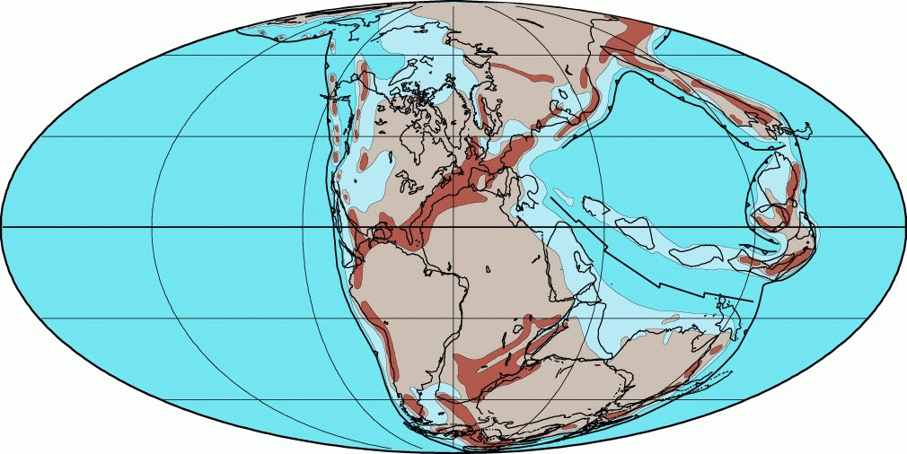
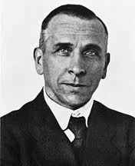
Ch 4.1 Continental Drift
Hypothesis by ALFRED WEGNER in 1912 (stated that continents can move)
Pangaea- first single land mass
Panthalassa- “all seas”- huge ocean surrounding Pangaea

Slide 3
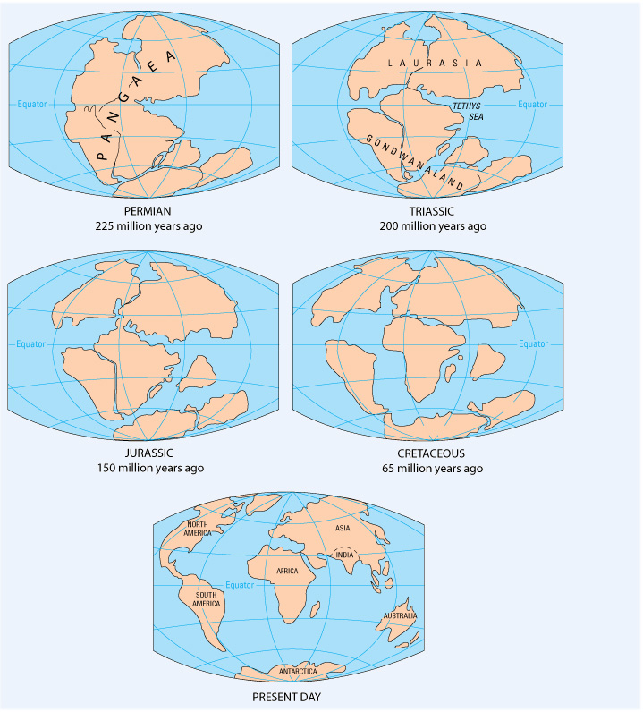

Slide 4
Evidence of Continental Drift
Fossils
Geologic evidence- age and type of rocks in the coastal regions
Changes in climatic patterns
Hypothesis still has strong opposition

Slide 5
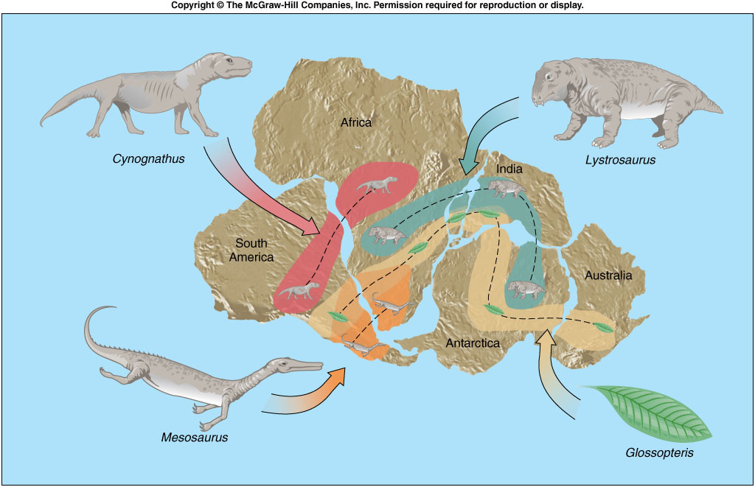

Slide 6
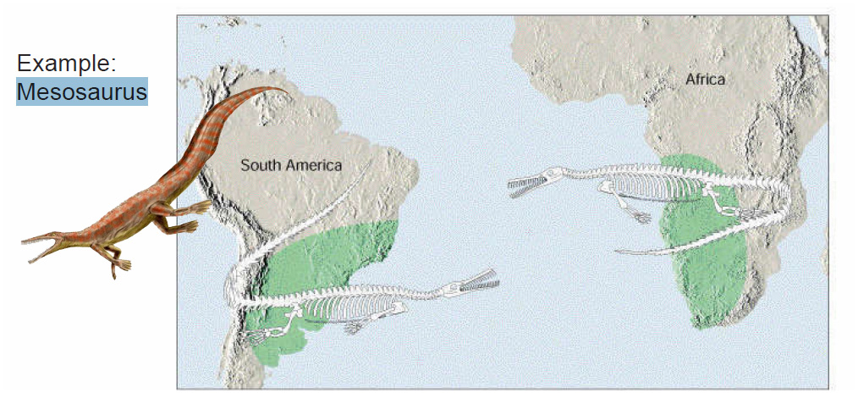

Slide 7
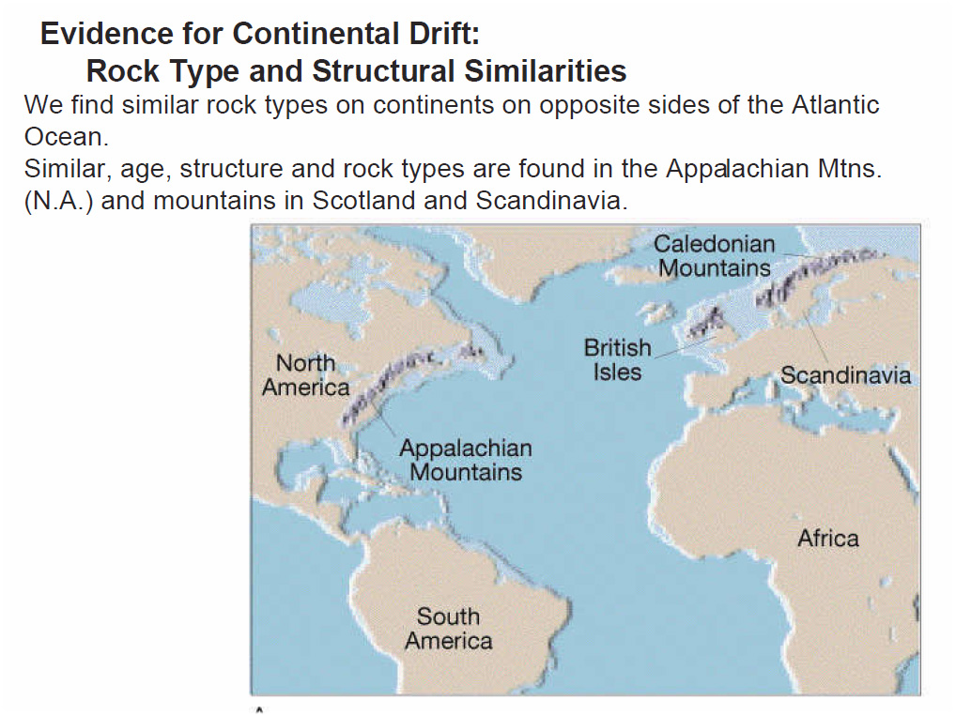

Slide 8
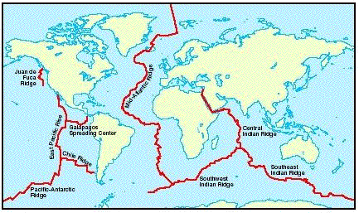
Seafloor Spreading
Mid-ocean ridges- 80,000km long system that winds its way around the earth (Mid-Atlantic Ridge is only a part of it)

Slide 9
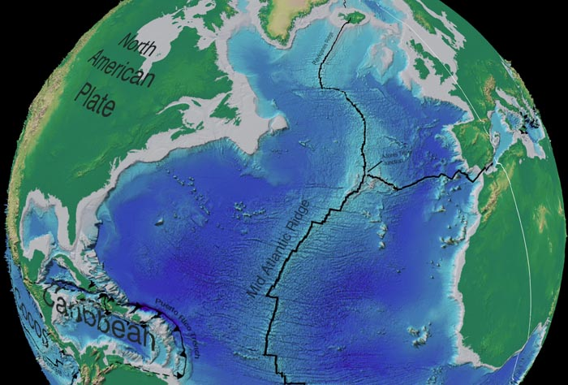
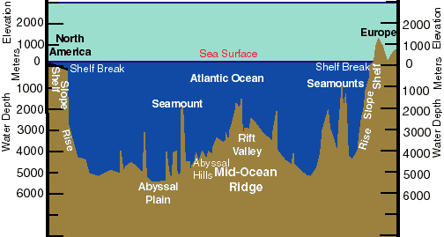
Mid-Atlantic Ridge
undersea mountain range with a steep narrow valley running down its center

Slide 10
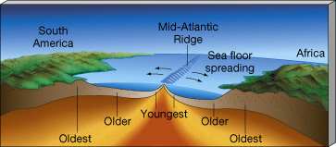
Oceanic vs. Continental
Ocean floor is very young compared to the age of continental rocks
Oceanic- 175 million years old
Continental- 4 billion years old

Slide 11
Renewal of ocean floor (Seafloor Spreading)
Suggested that the ridge was a place of upwelling of molten rock or magma
Ocean floor moving away from each side of the ridge and replaced by solidified rock (definition of seafloor spreading)
Moving at a rate of about 5cm per year

Slide 12
Theory of Plate Tectonics
Not only describes continental movement, but also proposes a possible explanation of why and how continents move
‘tectonics’- Greek for construction- study of the formation of the features in the earth’s crust
2 types: Oceanic (ocean floor material) and Continental (landmasses)

Slide 13
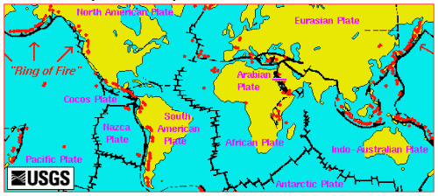
Lithosphere- made of oceanic/continental crust and the rigid upper mantle
  Forms the thin outer shell of the earth
  Over 12 known plates
    Some are moving towards, others away (mts and deep ocean trenches)
Asthenosphere- layer of plastic (flows slowly like putty) beneath the lithosphere

Slide 14
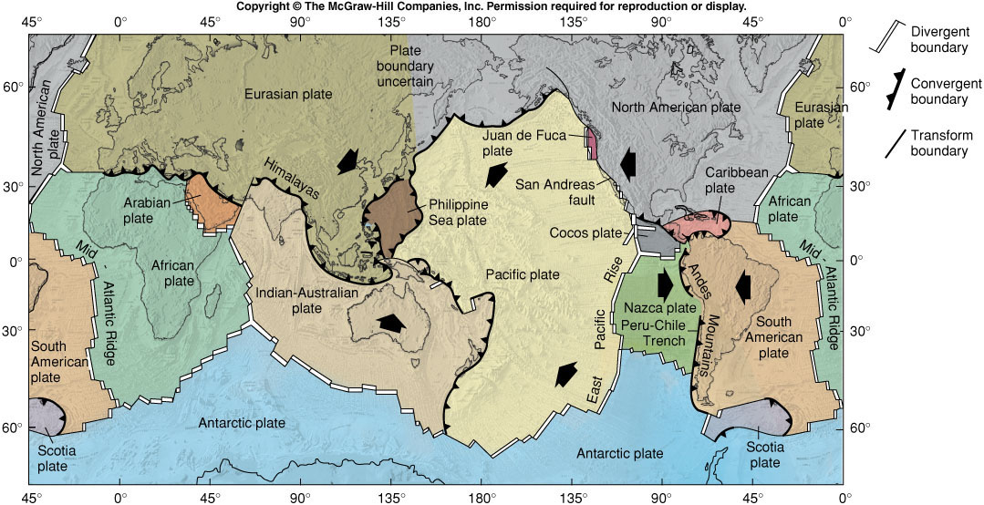

Slide 15
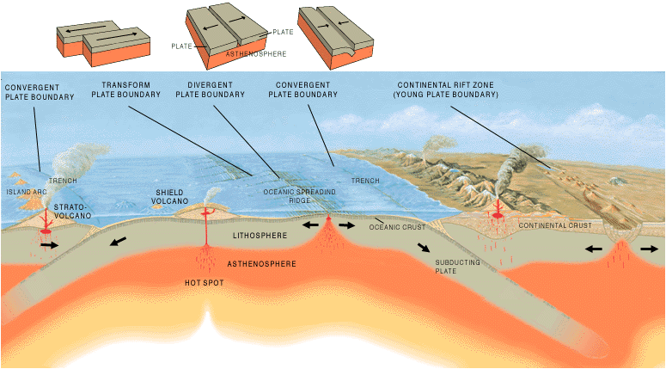
Lithospheric Plate Boundaries
Convergent (compression stress)
Divergent (tension stress)
Transform (shear stress)

Slide 16
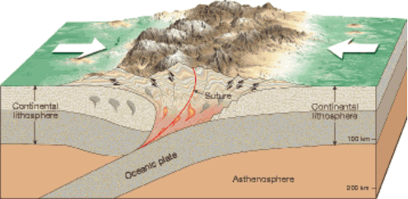
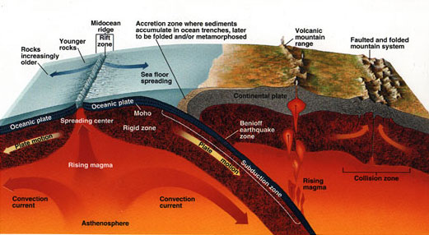
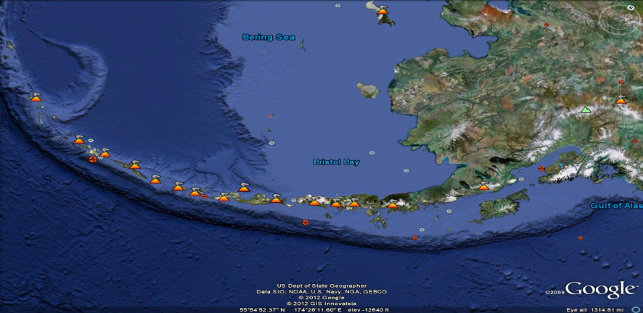
Convergent Boundaries
-Two plates are colliding
1)Oceanic vs. Continental: Oceanic is denser and is forced underneath Continental (SUBDUCTION ZONE forms a deep ocean trench) EX: Marianas Trench | 2)Continental vs. Continental: neither plate is subducted. Large mountain ranges form. EX. Himalayas | 3)Oceanic vs. Oceanic: deep ocean trench forms. Chain of volcanic islands form (island arc) Ex. Aleutian Islands

Slide 17
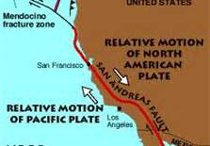
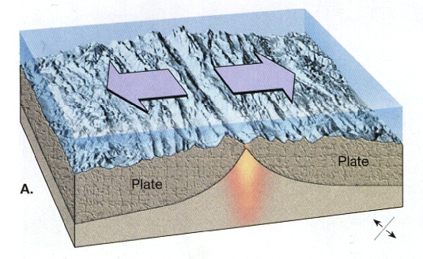
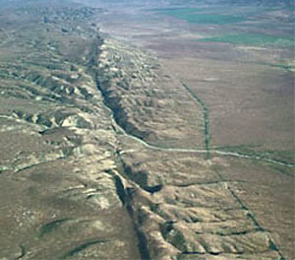
Divergent | Transform
Two plates are moving away from each other | Two plates are grinding past each other
Ex. Rift Valley in the Red Sea and Mid Atlantic Ridge | Ex. San Andreas Fault

Slide 18
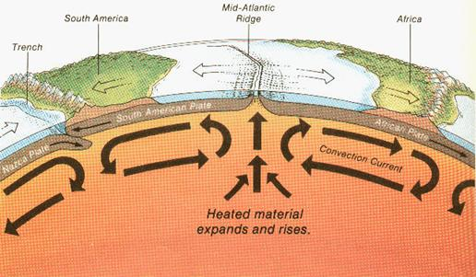
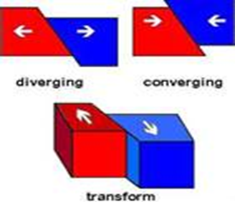
Causes of plate motion
Movement of lithospheric plates is caused by CONVECTION (heat rises, cold sinks)
Cycle of warm fluids rising and cool fluids sinking is called a convection current

Slide 19
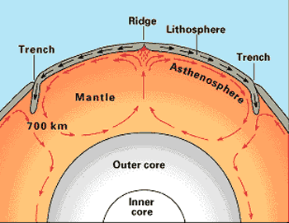

Slide 20
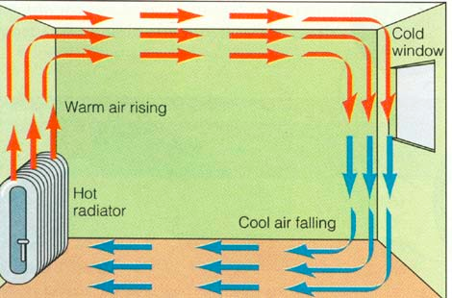

Slide 21
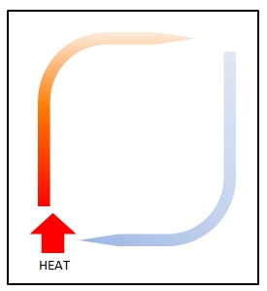

Slide 22
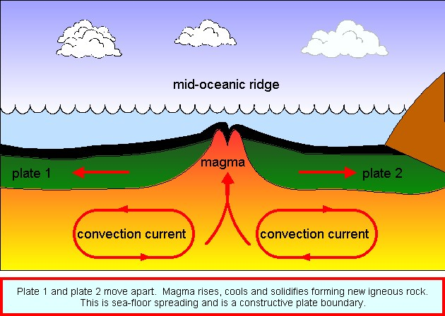

Slide 23
Your assignment
Add the colors blue & red to the convection currents.
Define a convection current.
In what part of the Earth are convection currents found?
What is a ridge? How do they form?
What is a trench? How do the form?
Cut out / match up / glue down the plate boundaries.
Read about the three types of plate boundaries and write 1-2 additional facts about each next to the pictures.

